Slide 1
ROB 550 & ML: Neural Net Block Detections
Stanley Lewis
02/07/2023
Additional Credit: J. Johnson, J. Pavlasek

Slide 2
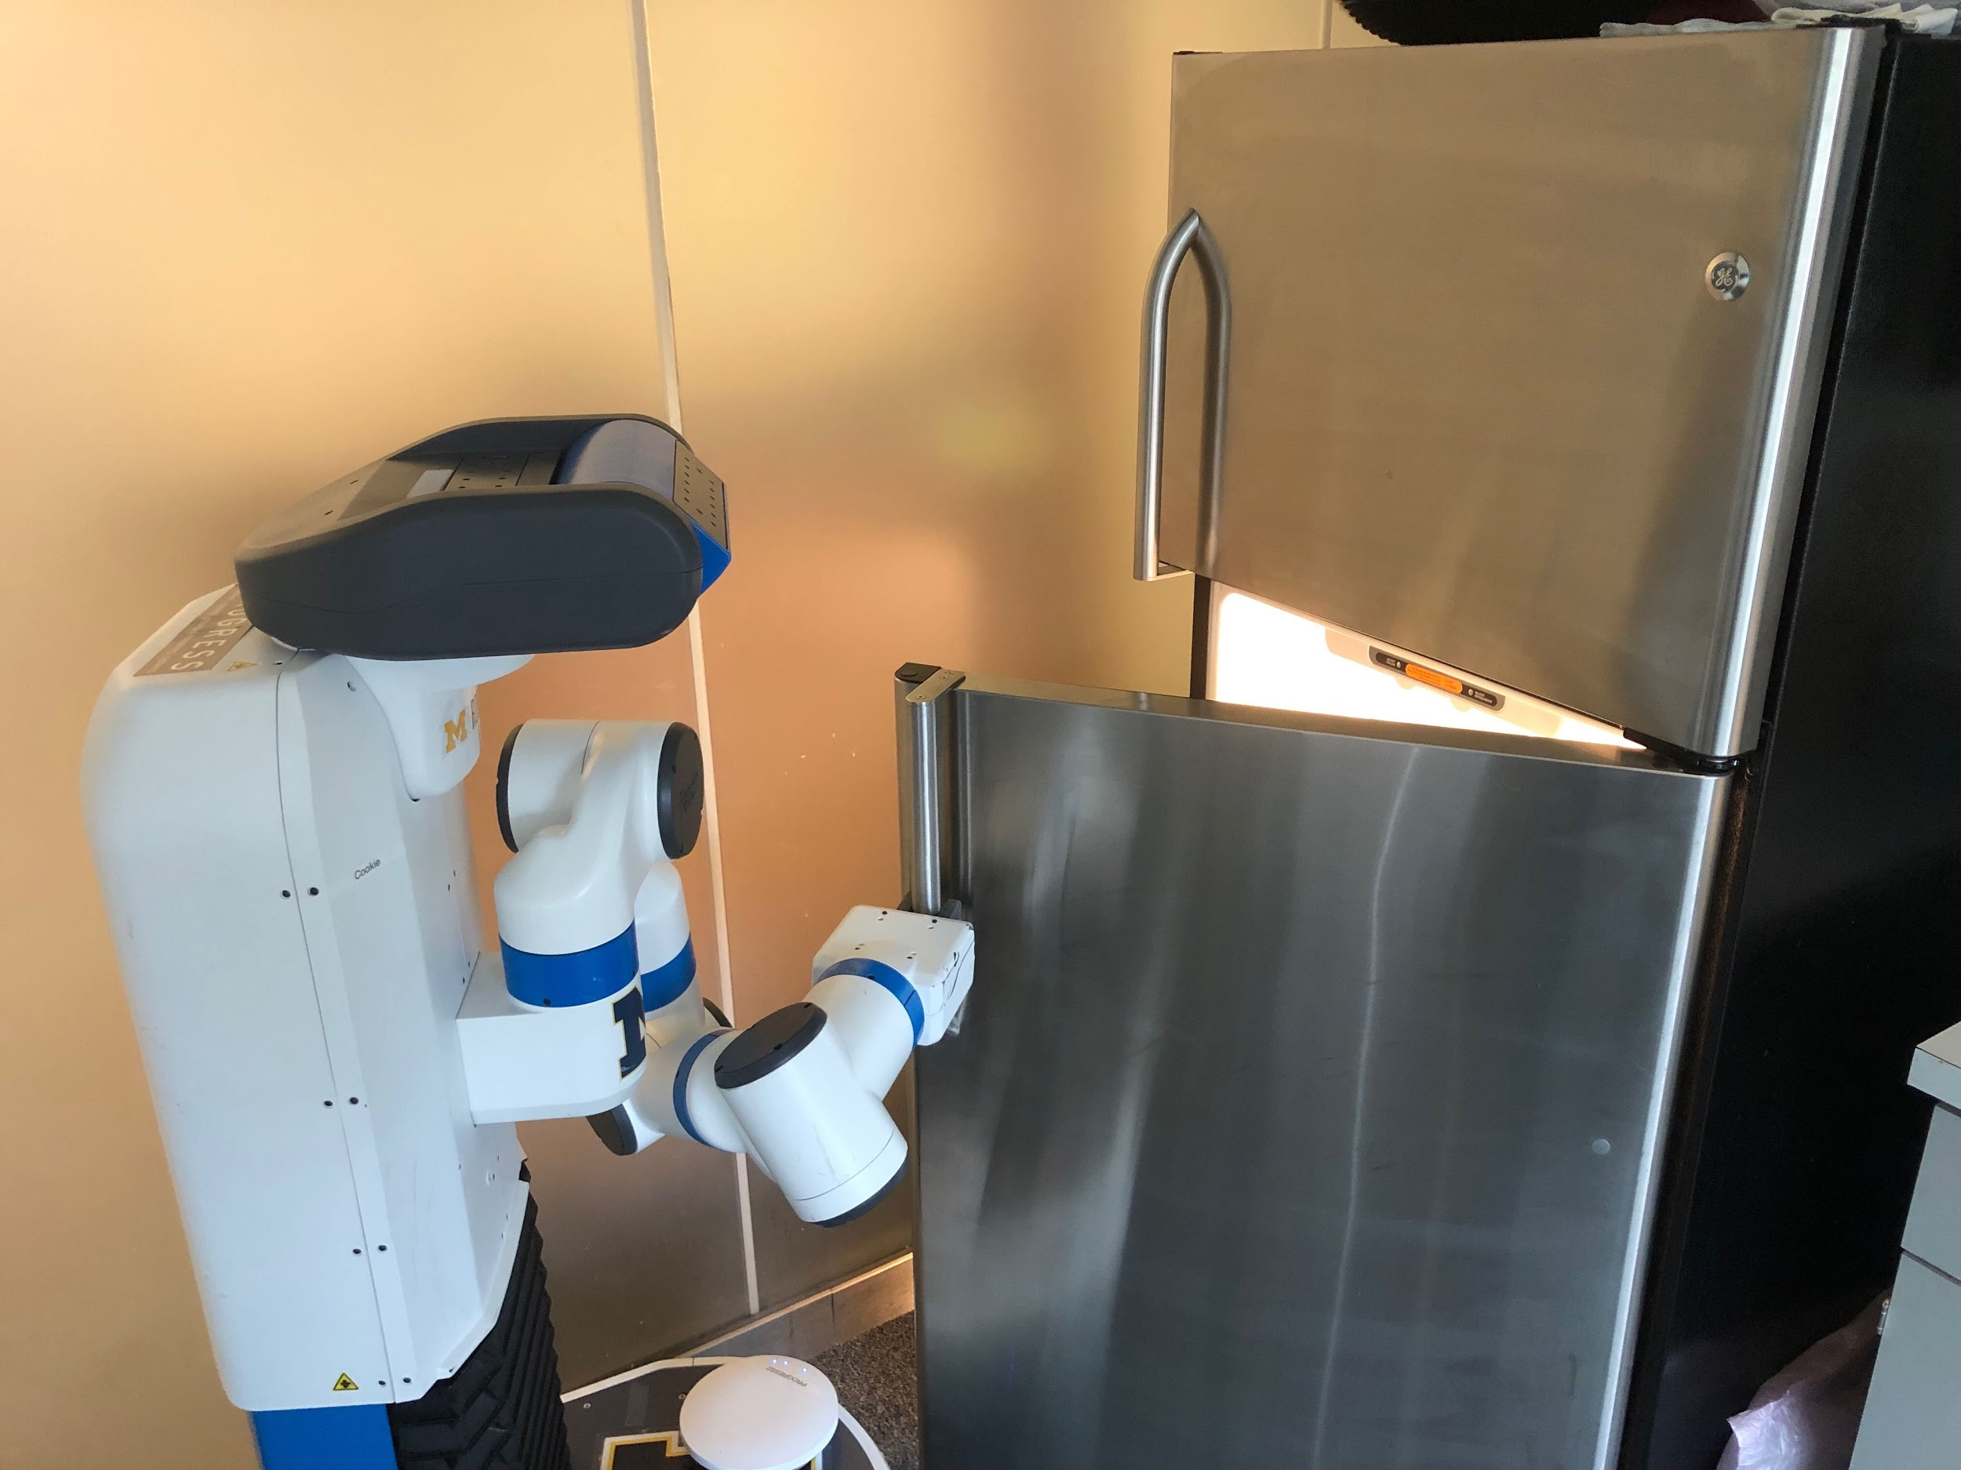
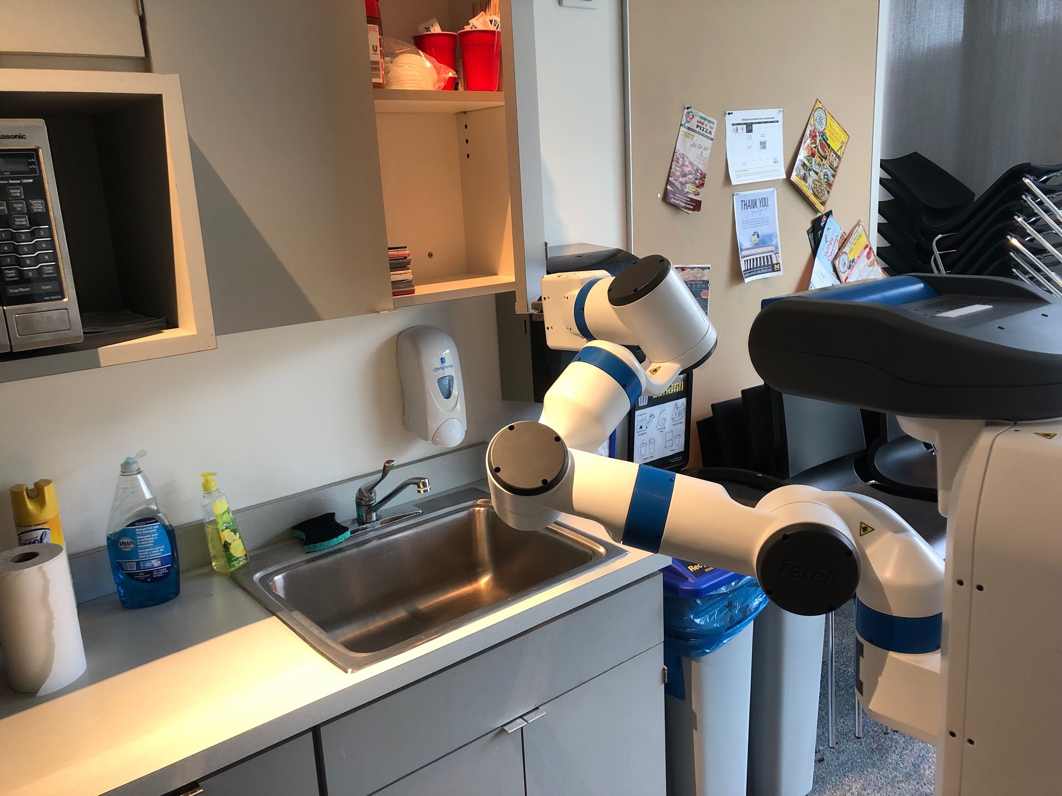
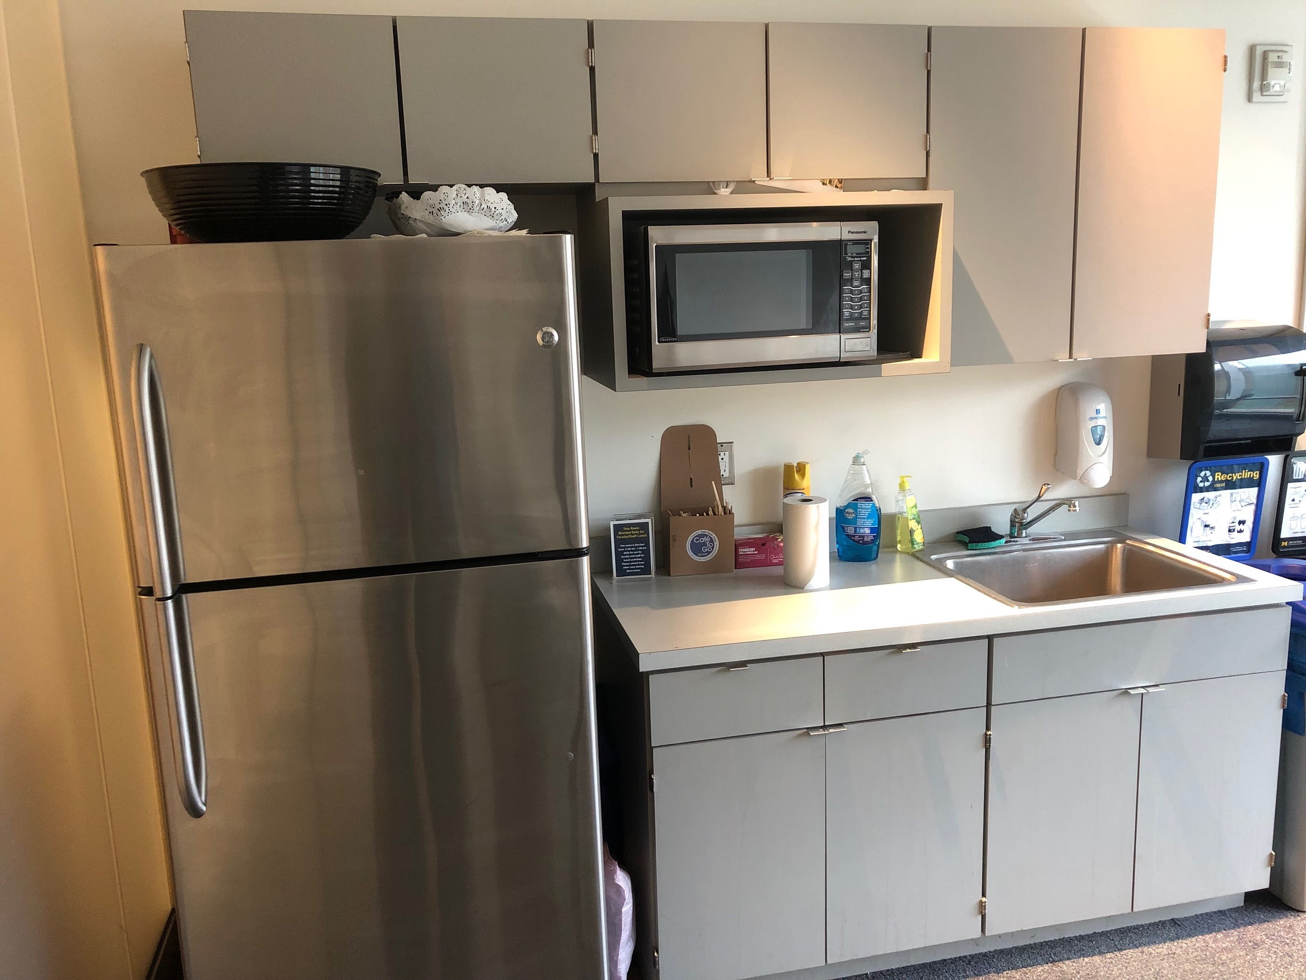
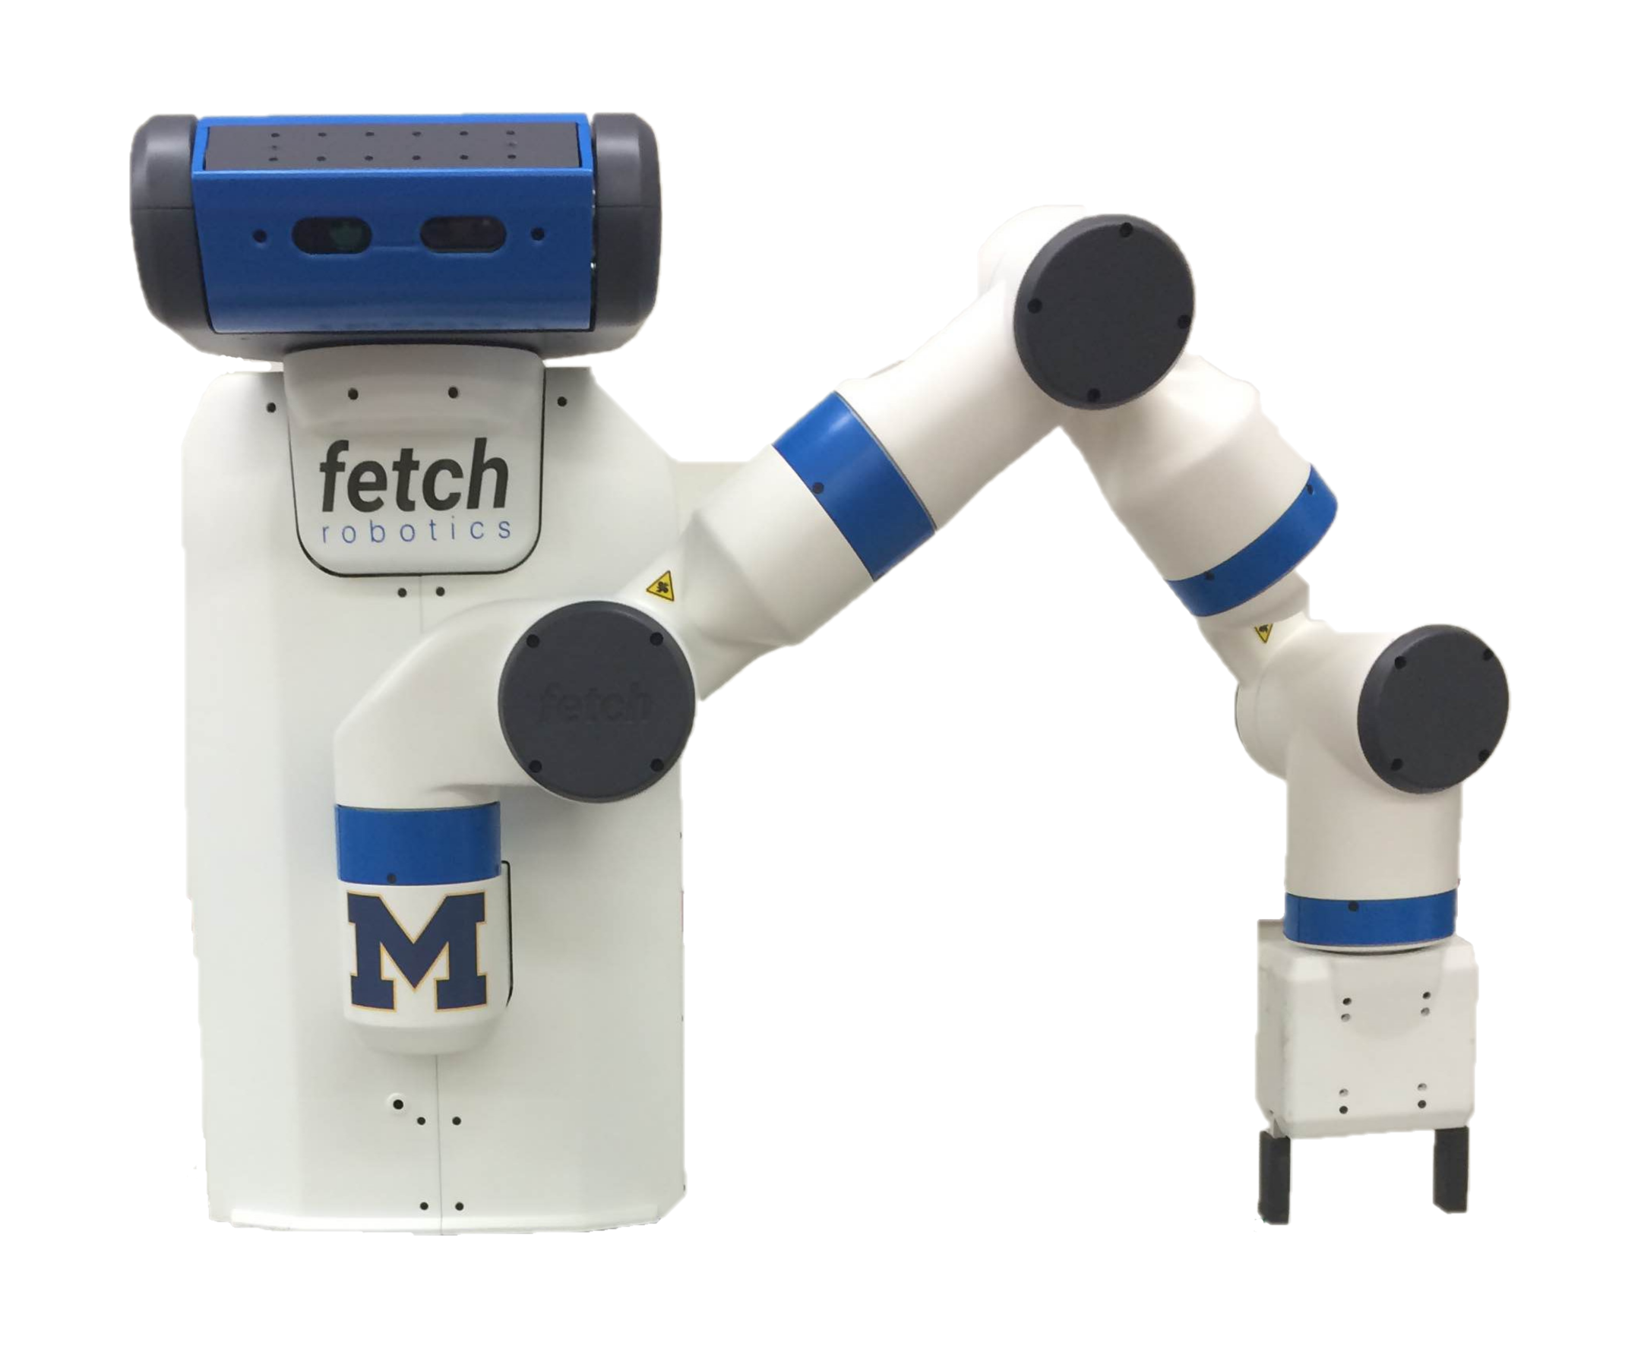
How can we make a robot see?

Slide 3
How can we make a robot see?
camera!

Slide 4
ROB 550 Block Detector: We will perform a computer vision task using a machine learning algorithm.
Specifically: a convolutional neural network for image segmentation

Slide 5
ROB 550 Block Detector: We will perform a computer vision task using a machine learning algorithm.
Presentation Scope:
Problem Space Discussion
Problem Setups
Neural Net 100k ft. overview
Example Notebook & Areas of Consideration

Slide 6
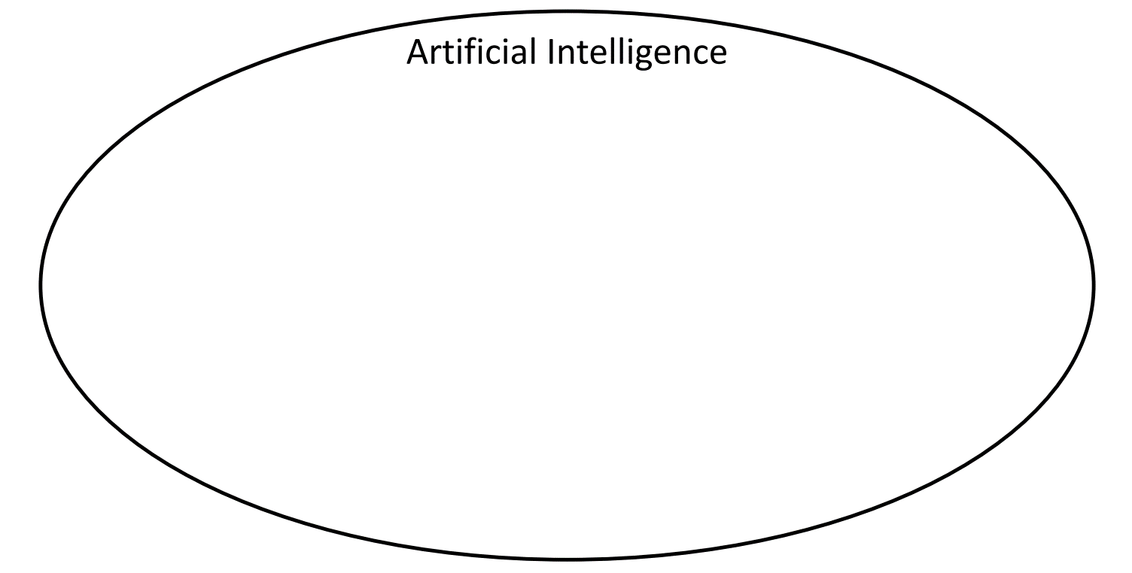
Credit: Justin Johnson, EECS 498 F20 (link)

Slide 7
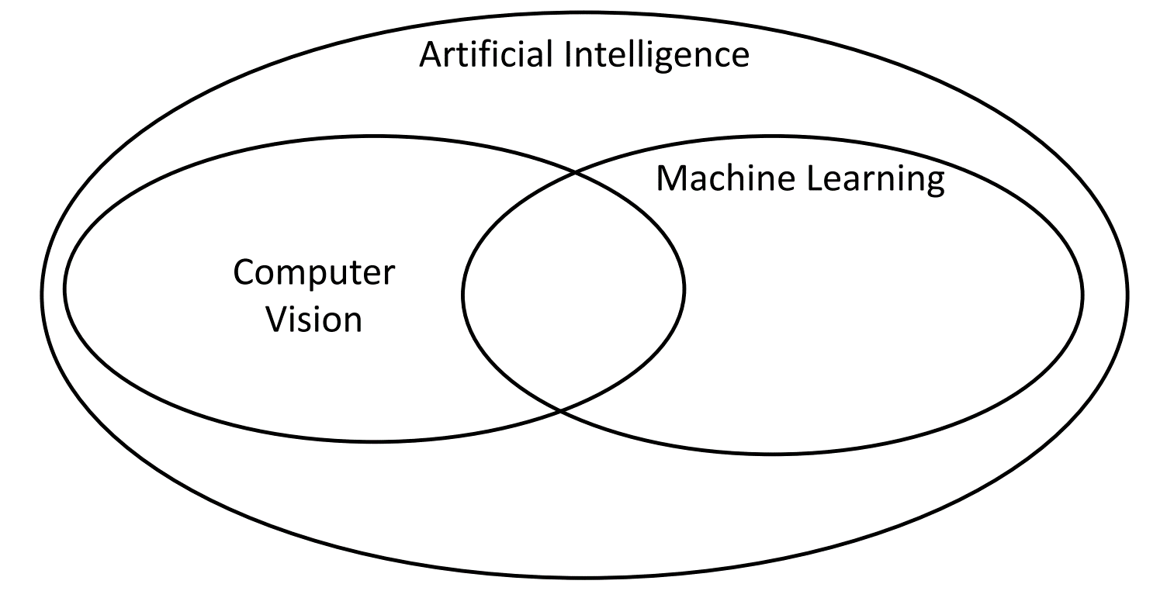
Credit: Justin Johnson, EECS 498 F20 (link)

Slide 8
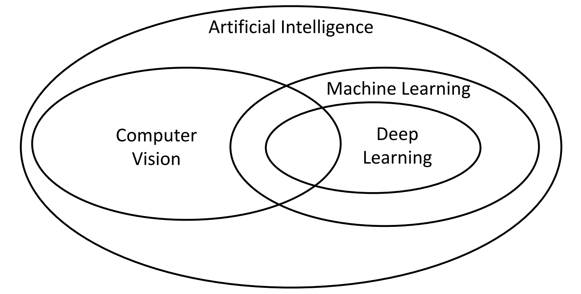
Block Detector
Credit: Justin Johnson, EECS 498 F20 (link)

Slide 9
Robotics
Block Detector
Natural Language Processing
Credit: Justin Johnson, EECS 498 F20 (link)

Slide 10
Machine Learning Terminology
Supervised Learning
Unsupervised Learning
Reinforcement Learning

Slide 11
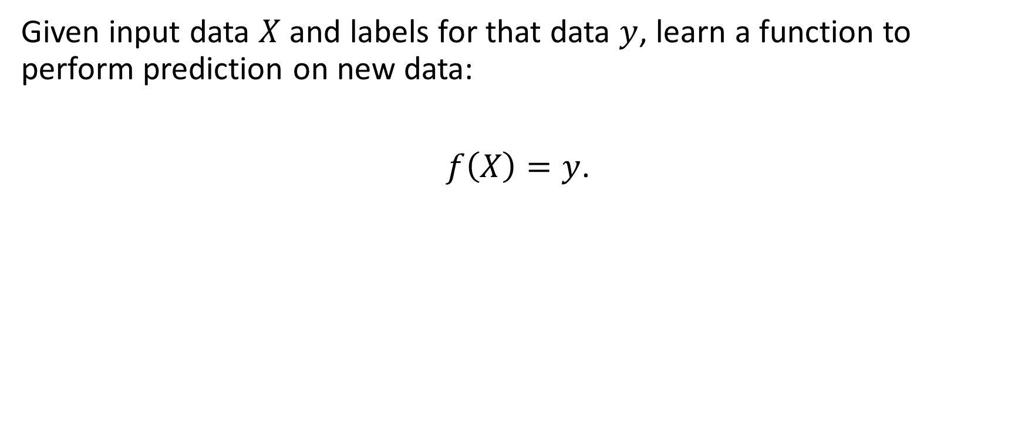
Supervised Learning
Given input data $X$ and labels for that data $y$, learn a function to perform prediction on new data:
$f\left(X\right)=y$.

Slide 12
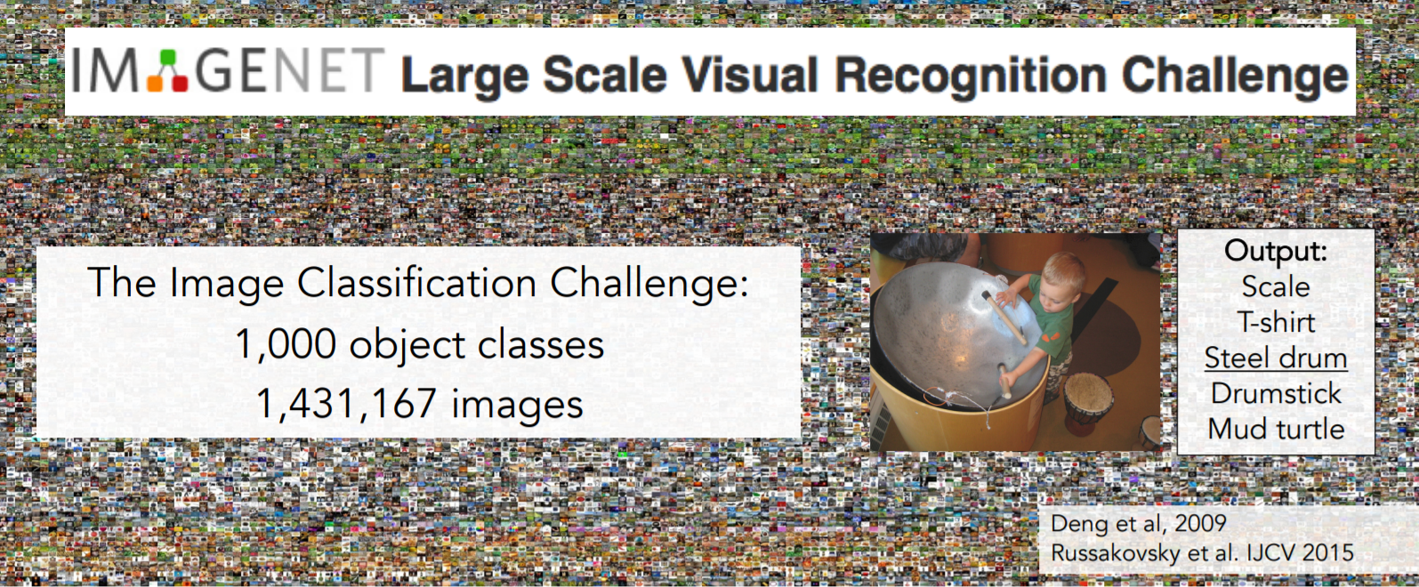
Supervised Learning

Slide 13
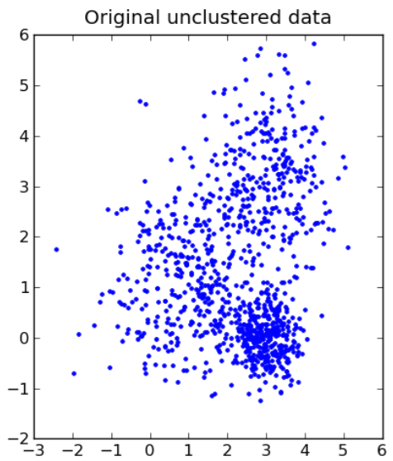
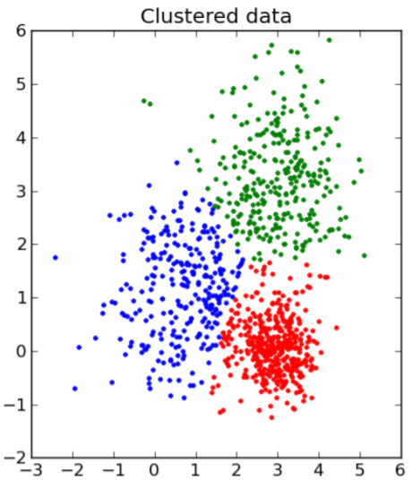
Unsupervised Learning
Given unlabeled data, learn a function over the input.
Source: Pineau, 2017 (link)
Notes:
Examples: Anomaly detection, auxiliary task for a supervised task

Slide 14
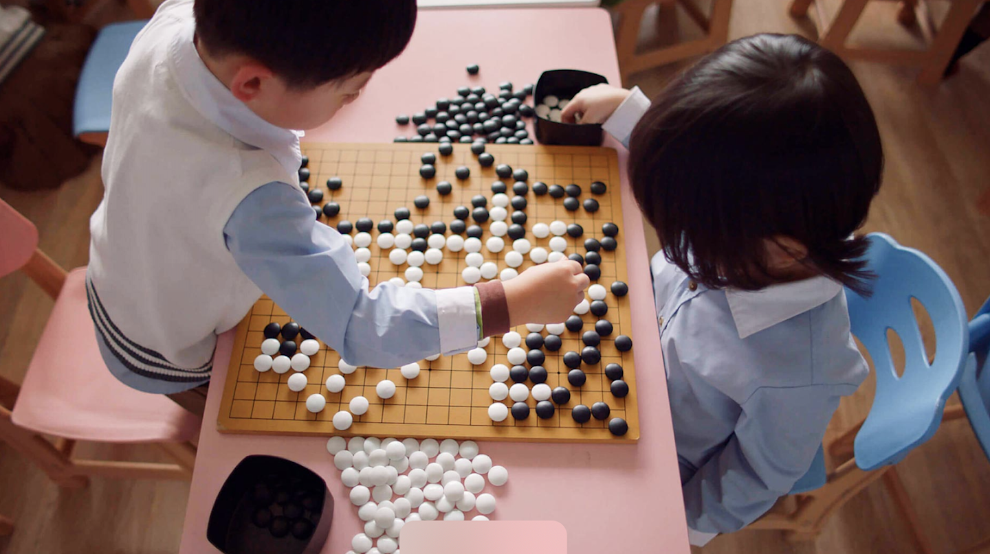

Reinforcement Learning
An agent learns a policy that maximizes a reward.
Beat the world Go champion in 2017.
DeepMind (link)

Slide 15
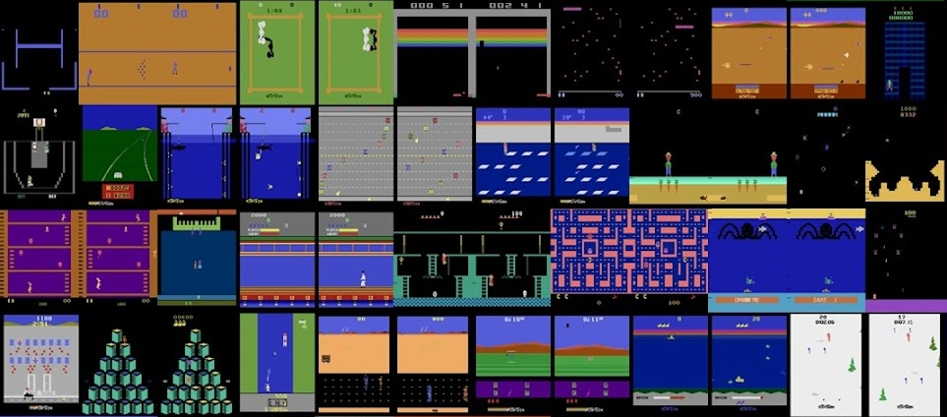
Reinforcement Learning
Outperforming humans at Atari games
Agent57: Outperforming the human Atari benchmark. [Puigdomènech, 2020]
Notes:
https://deepmind.com/blog/article/Agent57-Outperforming-the-human-Atari-benchmark

Slide 16
Machine Learning Algorithm
Training time:
Learn a prediction model by optimizing over a labeled dataset.
Testing time:
Use the model to perform prediction on new data.
We have to pick the data, the model, and the optimization method.

Slide 17
Machine Learning Terminology
Supervised Learning
Image Classification
Unsupervised Learning
Reinforcement Learning
Object Detection
Block Detector
Image Segmentation
Instance Segmentation

Slide 18
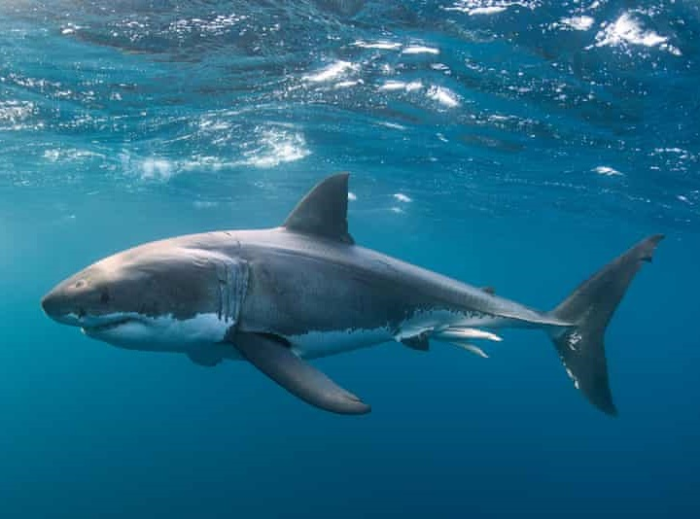
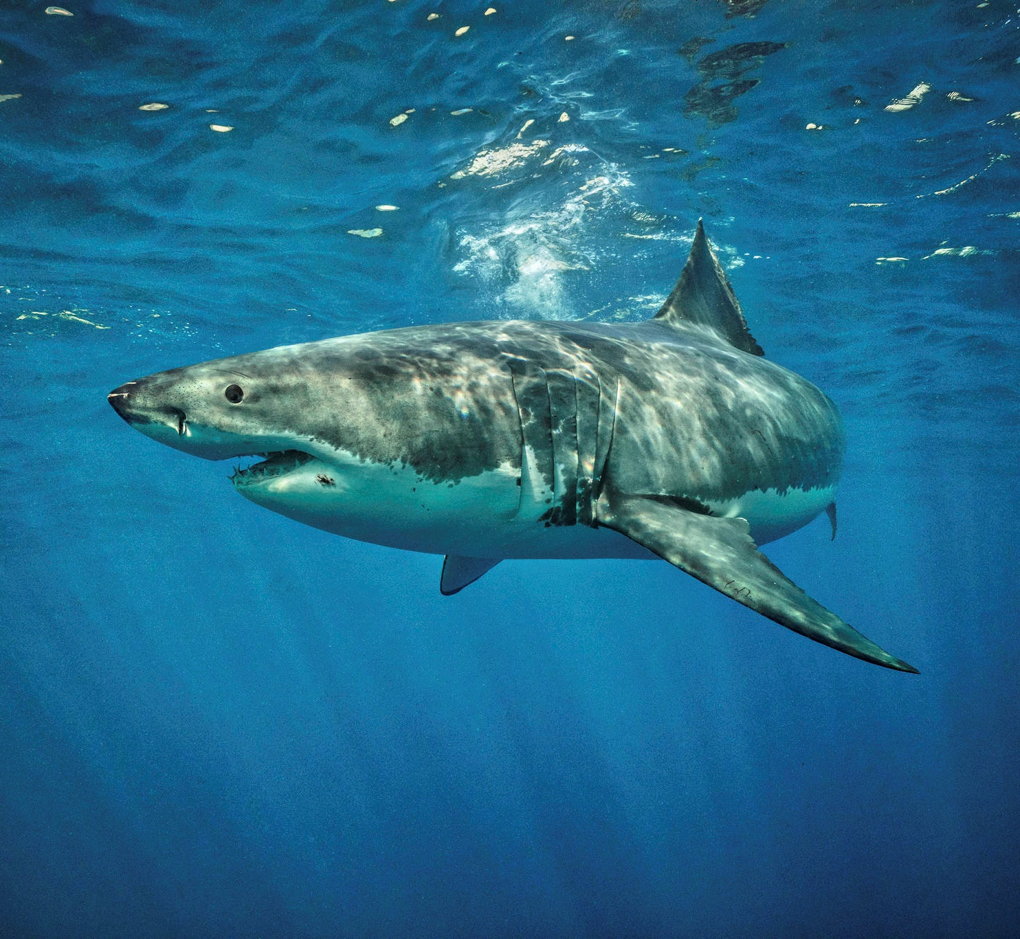
Machine Learning Terminology
What is in this picture?
Supervised Learning
Image Classification
Object Detection
Image Segmentation
“shark”
“shark”
Instance Segmentation

Slide 19

Machine Learning Terminology
What is in this picture?
Supervised Learning
Image Classification
Object Detection
Image Segmentation
Input: Images
Labels: Tags
Instance Segmentation

Slide 20
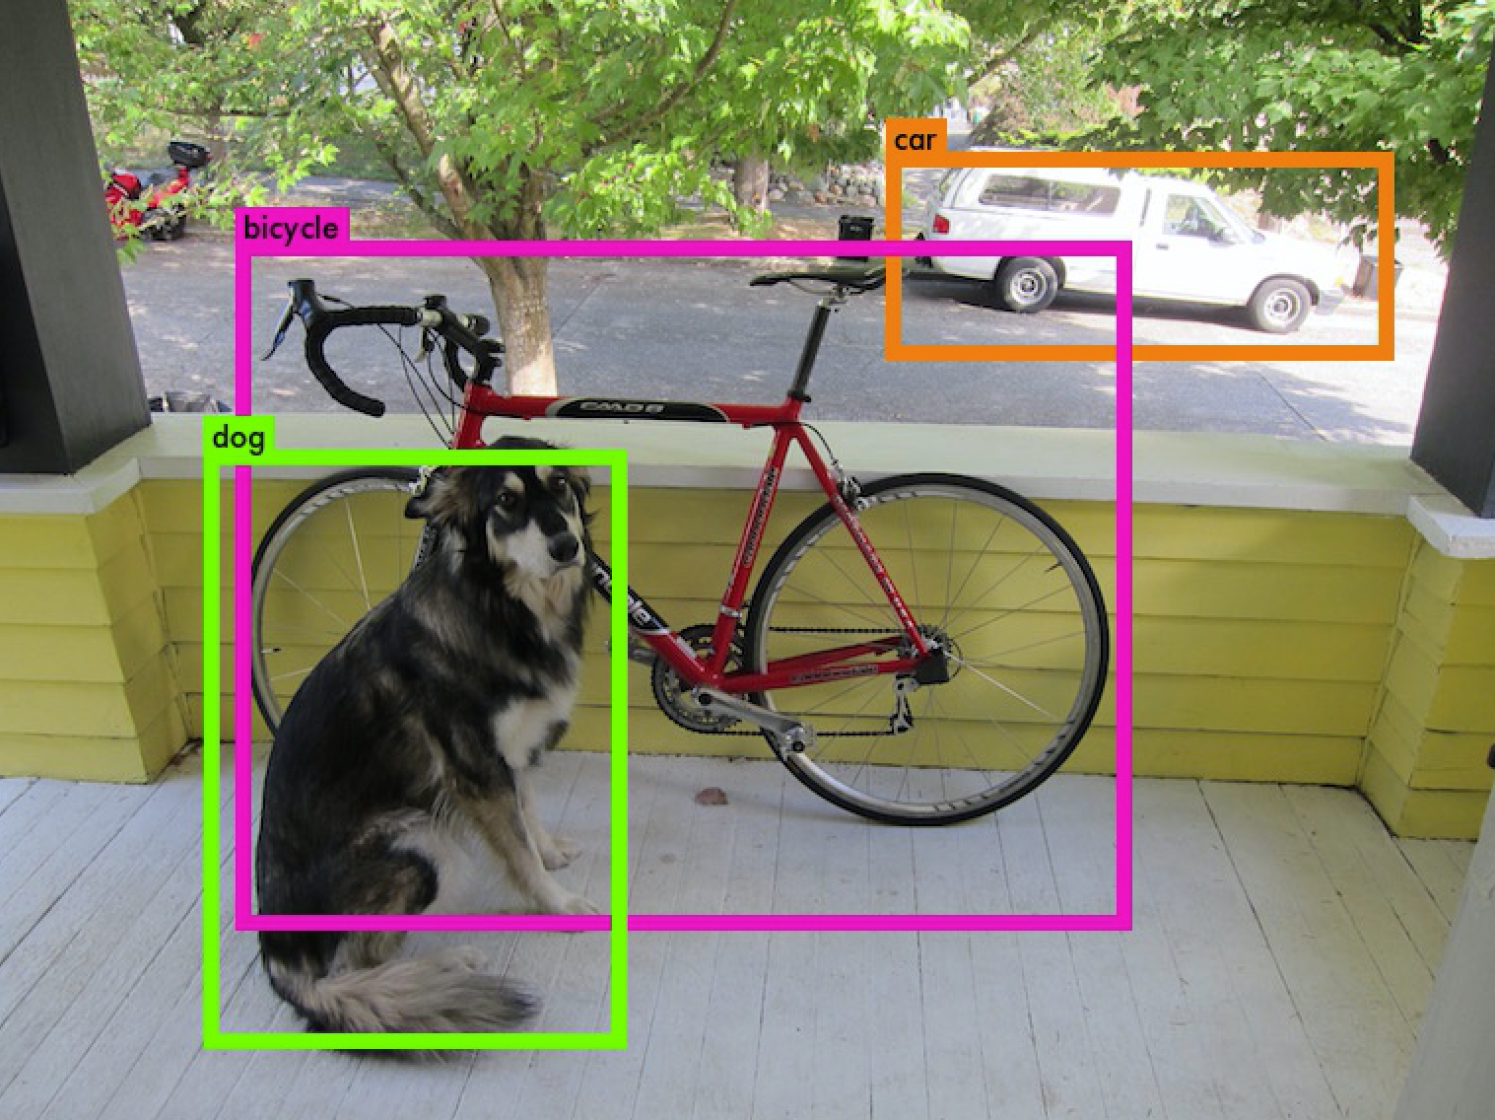
Machine Learning Terminology
Where are the objects?
Supervised Learning
Image Classification
Shark
Object Detection
Image Segmentation
Instance Segmentation
Input: Images
Labels: Bounding Boxes

Slide 21
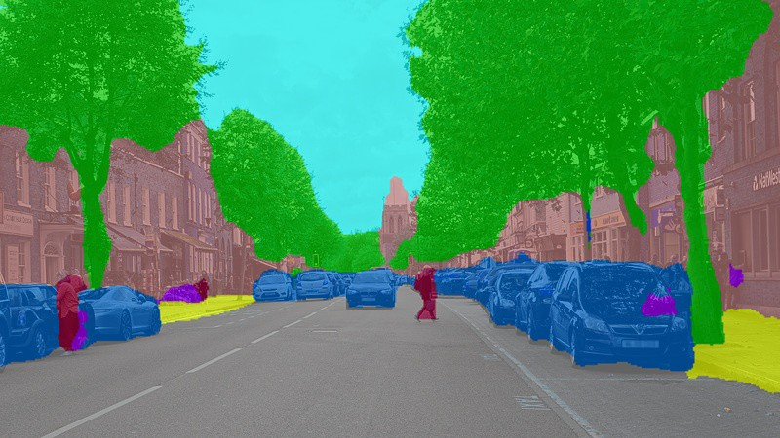
Machine Learning Terminology
What is each pixel’s label?
Supervised Learning
Image Classification
Object Detection
Image Segmentation
Instance Segmentation
Input: Images
Labels: Masks

Slide 22
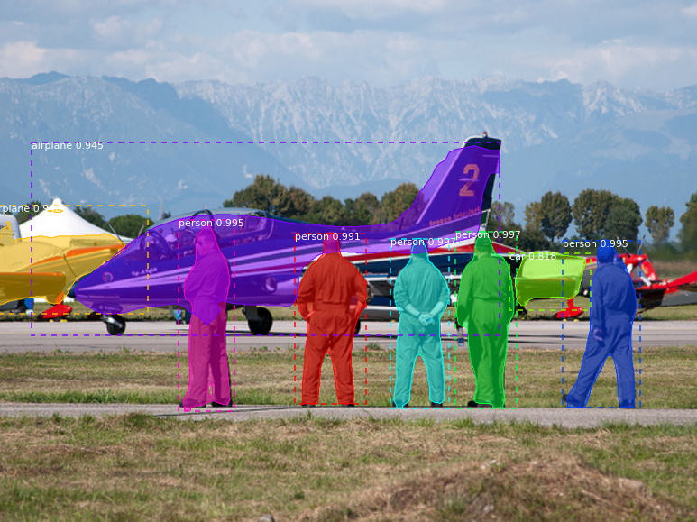
Machine Learning Terminology
Disambiguate every object in the scene
Supervised Learning
Image Classification
Object Detection
Image Segmentation
Instance Segmentation
Input: Images
Labels: Masks, Instances

Slide 23
Machine Learning Terminology
All of these require Training Data (maybe lots)
Supervised Learning
Image Classification
How to acquire?
Hand Labels
Generative Inference
Heuristic/Non-ML
Object Detection
Block Detector
Image Segmentation
Instance Segmentation

Slide 24

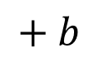
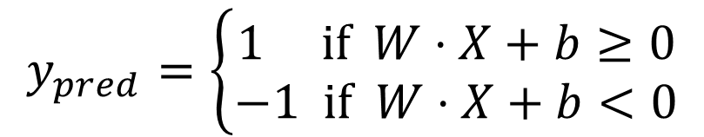
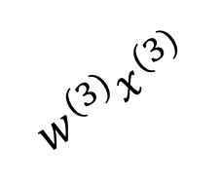
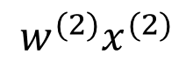
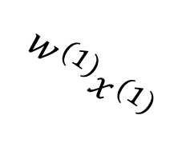
Neural Nets Crash Course: The perceptron
A perceptron is an algorithm for binary (linear!) classification.
$$w^{(1)}x^{(1)}$$
Feature
Bias
Weight
$$w^{(2)}x^{(2)}$$
$$Σ$$
$$+ b$$
Activation Function
$$y_{pred}=\left\{\begin{aligned}1 \text{if} W⋅X+b≥0 \\ −1 \text{if} W⋅X+b<0\end{aligned}\right.$$
$$w^{(3)}x^{(3)}$$

Slide 25

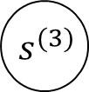
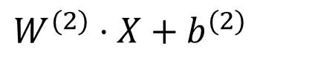
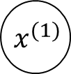



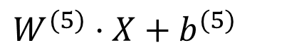

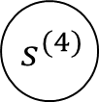

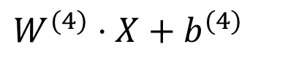

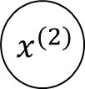

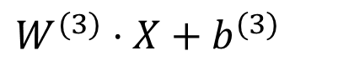
Neural Nets Crash Course: The perceptron
We can build a multi-class linear classifier as multiple perceptrons (without the )
class scores
$$Σ$$
$$s^{(2)}$$
$$W^{(2)}⋅X+b^{(2)}$$
$$x^{(1)}$$
$$Σ$$
$$s^{(3)}$$
$$W^{(3)}⋅X+b^{(3)}$$
$$x^{(2)}$$
$$Σ$$
$$s^{(4)}$$
$$W^{(4)}⋅X+b^{(4)}$$
$$x^{(3)}$$
$$Σ$$
$$s^{(5)}$$
$$W^{(5)}⋅X+b^{(5)}$$

Slide 26
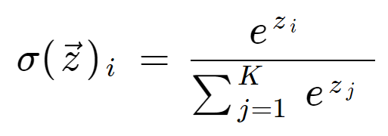
Neural Nets Crash Course: The perceptron
For multi-class classifiers, we then use a Softmax activation
class scores
$$Σ$$
$$s^{(2)}$$
$$x^{(1)}$$
$$Σ$$
$$s^{(3)}$$
$$x^{(2)}$$
$$Σ$$
$$s^{(4)}$$
$$x^{(3)}$$
$$Σ$$
$$s^{(5)}$$

Slide 27
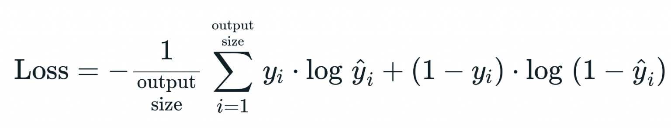
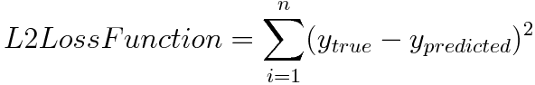
Neural Nets Crash Course: The loss function
Need to have a function to minimize for training
This is referred to as the loss function
L2 Loss
Cross Entropy Loss

Slide 28

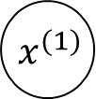






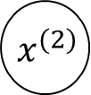

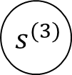
Building a Neural Network
We can stack up multiple “neurons” made up of linear functions and activation functions.
$$Σ$$
$$x^{(1)}$$
$$Σ$$
$$s^{(2)}$$
$$Σ$$
$$x^{(2)}$$
$$Σ$$
$$Σ$$
$$s^{(3)}$$
$$x^{(3)}$$
$$Σ$$

Slide 29
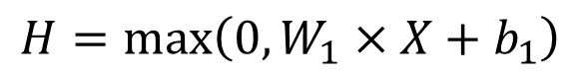
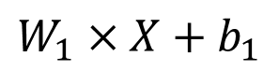
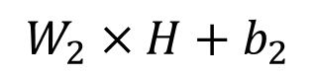
Fully Connected Neural Network
We call this a “fully connected” network because each node is connected to all nodes in the previous layer.
$$H=\max\left(0, W_{1}×X+b_{1}\right)$$
$$W_{1}×X+b_{1}$$
$$W_{2}×H+b_{2}$$
$$Σ$$
$$x^{(1)}$$
$$Σ$$
$$s^{(2)}$$
$$Σ$$
$$x^{(2)}$$
$$Σ$$
$$Σ$$
$$s^{(3)}$$
$$x^{(3)}$$
$$Σ$$
Output Layer
Input Layer
Hidden Layer

Slide 30
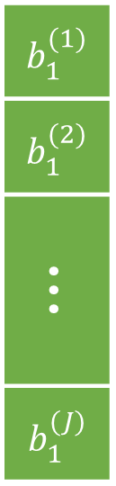
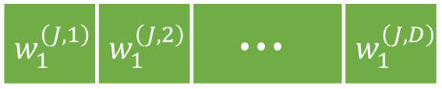


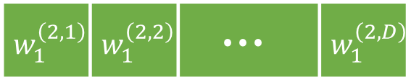
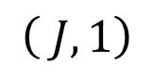

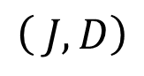

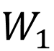
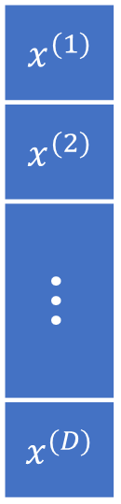
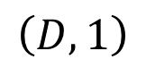
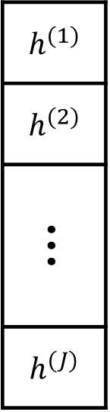

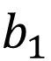

Neural Network Computation
Input image
Biases to learn
Weights to learn
$$h^{(1)}$$
$$h^{(2)}$$
$$∙∙∙$$
$$h^{(J)}$$
$$w_{1}^{\left(1,1\right)}$$ | $$w_{1}^{\left(1,2\right)}$$ | $$∙∙∙$$ | $$w_{1}^{\left(1,D\right)}$$
$$x^{(1)}$$
$$x^{(2)}$$
$$∙∙∙$$
$$x^{(D)}$$
$$b_{1}^{(1)}$$
$$b_{1}^{(2)}$$
$$∙∙∙$$
$$b_{1}^{(J)}$$
$$w_{1}^{\left(2,1\right)}$$ | $$w_{1}^{\left(2,2\right)}$$ | $$∙∙∙$$ | $$w_{1}^{\left(2,D\right)}$$
$$=$$
$$×$$
$$+$$
max
, 0
$$⋅⋅⋅$$
$$w_{1}^{\left(J,1\right)}$$ | $$w_{1}^{\left(J,2\right)}$$ | $$∙∙∙$$ | $$w_{1}^{\left(J,D\right)}$$
$$W_{1}$$
$$X$$
$$b_{1}$$
Hidden layer
shapes:
$$\left( J,D\right)$$
$$\left(D,1\right)$$
$$\left( J,1\right)$$
rows
columns

Slide 31
Backpropagation
Backpropagation is an algorithm to compute gradients of arbitrarily large networks.
It uses the chain rule (from calculus).

Slide 32




Backpropagation
Backpropagation is an algorithm to compute gradients of arbitrarily large networks.
Step 1: Express a function as a graph.
$$q=x+y$$
$$f\left(x, y, z\right)=\left(x+y\right)⋅z$$
$$f=q⋅z$$

Slide 33




Backpropagation
Backpropagation is an algorithm to compute gradients of arbitrarily large networks.
Step 2: Compute gradients.
$$\frac{∂q}{∂x}$$
$$f\left(x, y, z\right)=\left(x+y\right)⋅z$$
$$q=x+y$$
$\frac{∂f}{∂x}=\frac{∂q}{∂x}$ $\frac{∂f}{∂q}=1⋅z$
$$\frac{∂f}{∂q}$$
$$f=q⋅z$$
The chain rule!

Slide 34


Backpropagation
Backpropagation is an algorithm to compute gradients of arbitrarily large networks.
Step 2: Compute gradients.
$$f\left(x, y, z\right)=\left(x+y\right)⋅z$$
$$q=x+y$$
$\frac{∂f}{∂y}=\frac{∂q}{∂y}$ $\frac{∂f}{∂q}=1⋅z$
$$\frac{∂f}{∂q}$$
$$f=q⋅z$$
$$\frac{∂q}{∂y}$$

Slide 35


Backpropagation
Backpropagation is an algorithm to compute gradients of arbitrarily large networks.
Step 2: Compute gradients.
$$f\left(x, y, z\right)=\left(x+y\right)⋅z$$
$$q=x+y$$
$$\frac{∂f}{∂z}=q$$
$$f=q⋅z$$
$$\frac{∂f}{∂z}$$

Slide 36









Backpropagation
Backpropagation is an algorithm to compute gradients of arbitrarily large networks.
Instead of computing the derivative of the loss for a huge network, compute the gradient of each layer with respect to the input.
$$h^{(1)}$$
$$x^{(1)}$$
$$h^{(2)}$$
$$s^{(1)}$$
$$x^{(2)}$$
$$h^{(3)}$$
$$s^{(2)}$$
Then we can propagate the gradients backwards through the graph.
$$x^{(3)}$$
$$h^{(4)}$$
Output Layer
Input Layer
Hidden Layer
That’s why it’s called the backward pass!

Slide 37

Convolutional Neural Networks
Many modern deep learning methods for computer vision use Convolutional Neural Networks (CNNs).
Instead of flattening the image into a vector and having a giant weight matrix, we slide a kernel across the image. This is a convolution.
This model assumes that parts of the image close to each other likely have similar features.
(link)

Slide 38

Convolutional Neural Networks
Many modern deep learning methods for computer vision use Convolutional Neural Networks (CNNs).
(link)
Often use linear layers at the end!

Slide 39













Deep Neural Networks
The number of hidden layers and the size of each hidden layer are hyperparameters we need to pick.
Must consider proper activation functions in order to avoid problems related to diminishing gradients.
$$X$$
$$h_{1}$$
$$W_{2}$$
$$h_{2}$$
$$W_{3}$$
$$h_{3}$$
$$W_{4}$$
$$h_{4}$$
$$W_{5}$$
$$h_{5}$$
$$W_{1}$$
$$W_{6}$$
$$f\left(X\right)$$

Slide 40
To The Colab Notebook
https://colab.research.google.com/drive/1-rTFxb7fiXRPD6H2qstjA2TLsqSm3hdu?usp=sharing

Slide 41
Making It work
Train, Test, Validation datasets – need to make bigger!
Getting data
Collect manually: https://labelstud.io/
Collect semi-automatically
Use your existing block detector to label images
Data augmentation
Pixelwise perturbations – random backgrounds, salt & pepper noise, etc.
Translation, Rotation perturbations
Cut & Paste of labeled pixels
Use annotation utility – YOLOv5 instance segmentation
https://github.com/ultralytics/yolov5/releases/v7.0
Roboflow.com
Bare minimum viable number of images ~66 (with augmentations)

Slide 42
Making It work
Network Setups
How fast do you want this to run?
Training can take a very long time
More parameters == more training data == longer training time
Include depth?
Reconsider the problem: is image segmentation the right task?
What if:
Block detection in depth
Network does simple image classification

Slide 43
Fin.
Questions?

